Slide 1
Signal Processing First
LECTURE #3
Phasor Addition Theorem
© 2003, JH McClellan & RW Schafer

Slide 2
READING ASSIGNMENTS
This Lecture:
  Chapter 2, Section 2-6
Other Reading:
  Appendix A: Complex Numbers
  Appendix B: MATLAB
  Next Lecture: start Chapter 3
© 2003, JH McClellan & RW Schafer

Slide 3
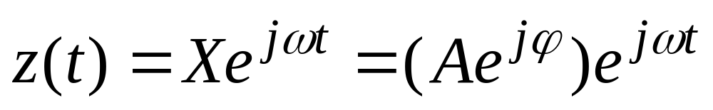
LECTURE OBJECTIVES
Phasors = Complex Amplitude
  Complex Numbers represent Sinusoids
Develop the ABSTRACTION:
  Adding Sinusoids = Complex Addition
  PHASOR ADDITION THEOREM
© 2003, JH McClellan & RW Schafer

Slide 4
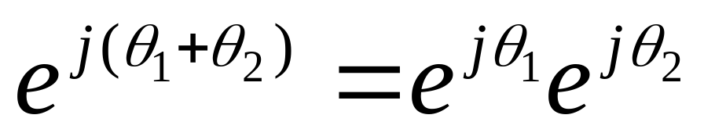
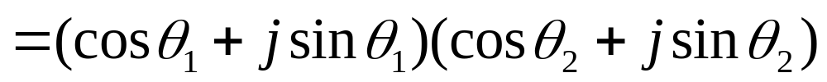
AVOID Trigonometry
Algebra, even complex, is EASIER !!!
Can you recall cos(θ₁+θ₂) ?
Use: real part of e^{j(θ1+θ2)} = cos(θ₁+θ₂)
© 2003, JH McClellan & RW Schafer

Slide 5
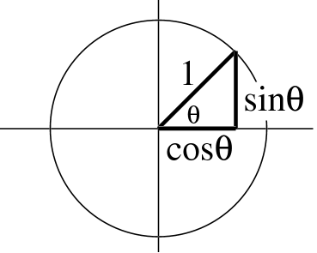
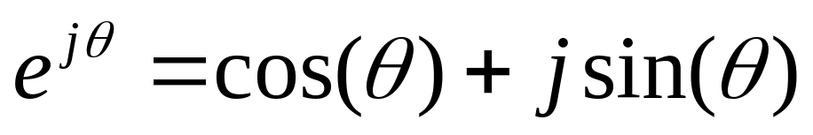
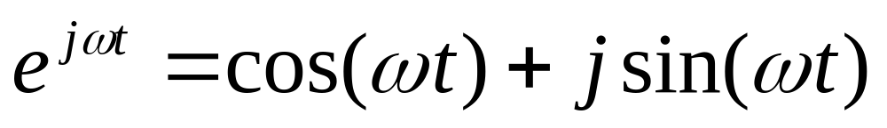
Euler’s FORMULA
Complex Exponential
  Real part is cosine
  Imaginary part is sine
  Magnitude is one
© 2003, JH McClellan & RW Schafer

Slide 6
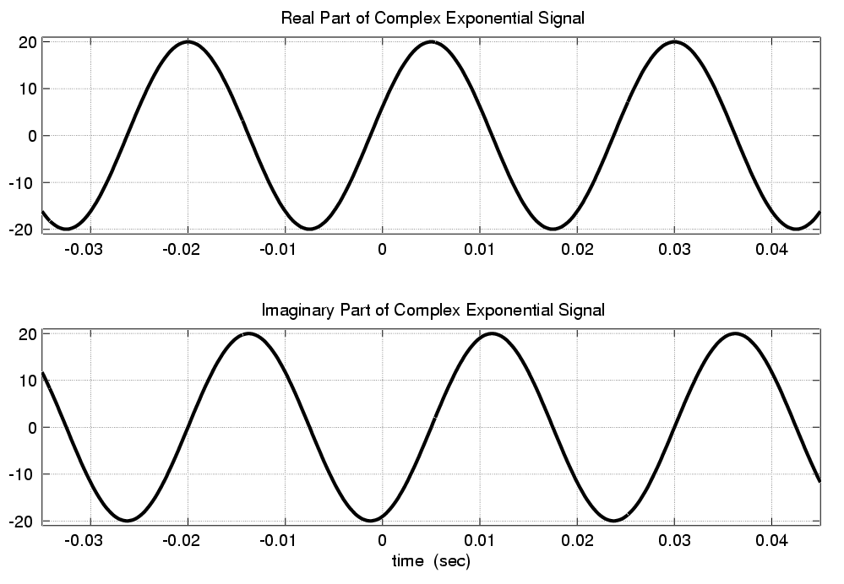
Real & Imaginary Part Plots
PHASE DIFFERENCE = π/2
© 2003, JH McClellan & RW Schafer

Slide 7
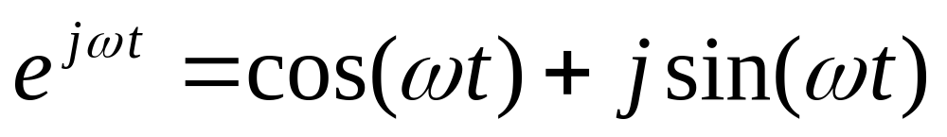
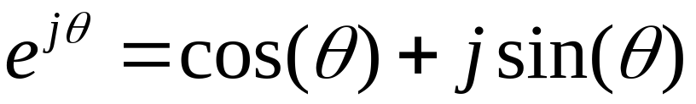
COMPLEX EXPONENTIAL
Interpret this as a Rotating Vector
  θ = ωt
  Angle changes vs. time
  ex: ω=20π rad/s
  Rotates 0.2π in 0.01 secs
© 2003, JH McClellan & RW Schafer

Slide 8
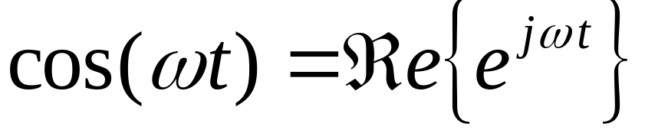
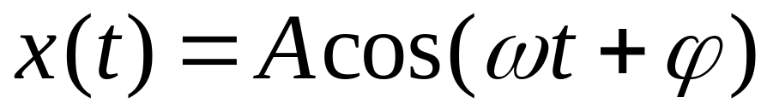
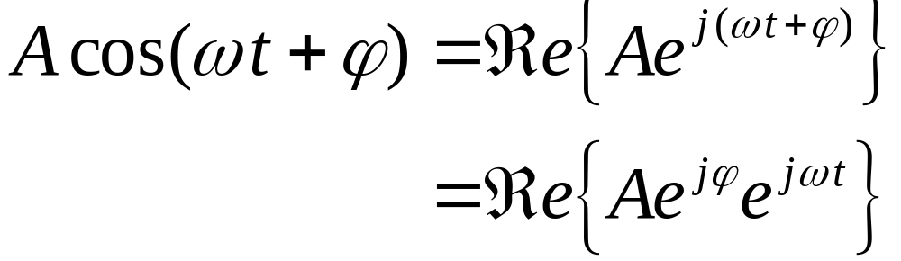
Cos = REAL PART
Real Part of Euler’s
General Sinusoid
So,
© 2003, JH McClellan & RW Schafer

Slide 9
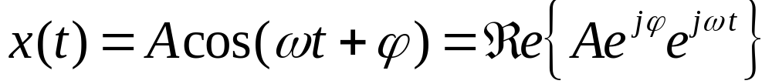
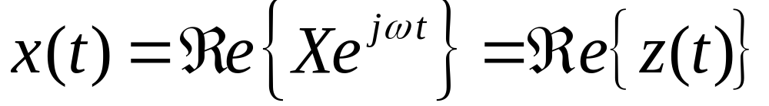
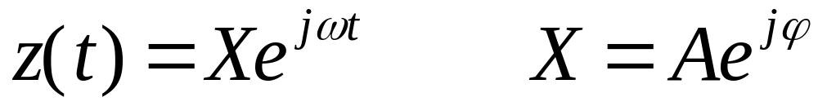
COMPLEX AMPLITUDE
General Sinusoid
Sinusoid = REAL PART of (Ae^{jφ})e^{jωt}
Complex AMPLITUDE = X
© 2003, JH McClellan & RW Schafer

Slide 10
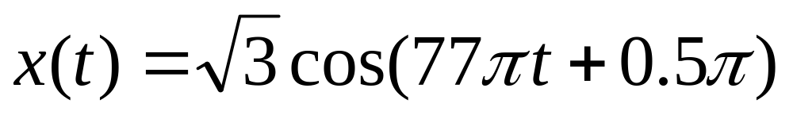
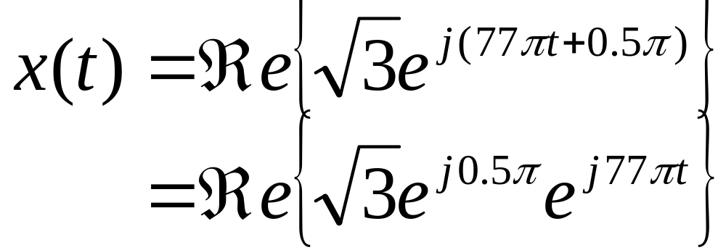
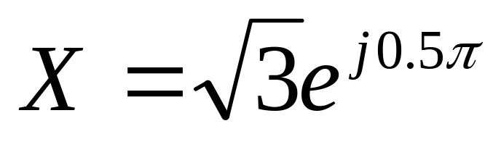
POP QUIZ: Complex Amp
Find the COMPLEX AMPLITUDE for:
Use EULER’s FORMULA:
© 2003, JH McClellan & RW Schafer

Slide 11
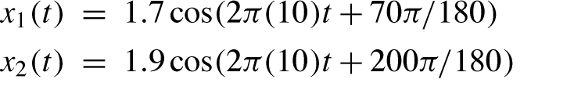
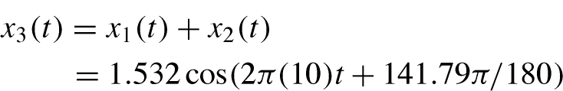
WANT to ADD SINUSOIDS
ALL SINUSOIDS have SAME FREQUENCY
HOW to GET {Amp,Phase} of RESULT ?
© 2003, JH McClellan & RW Schafer

Slide 12
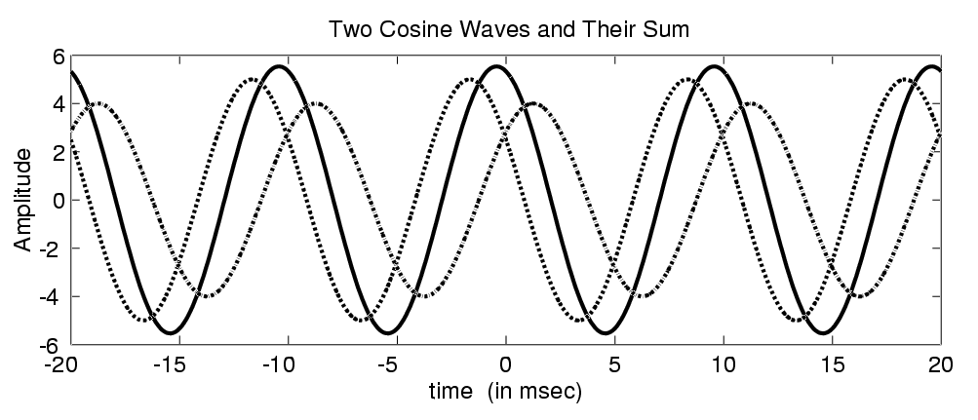
ADD SINUSOIDS
Sum Sinusoid has SAME Frequency
© 2003, JH McClellan & RW Schafer

Slide 13
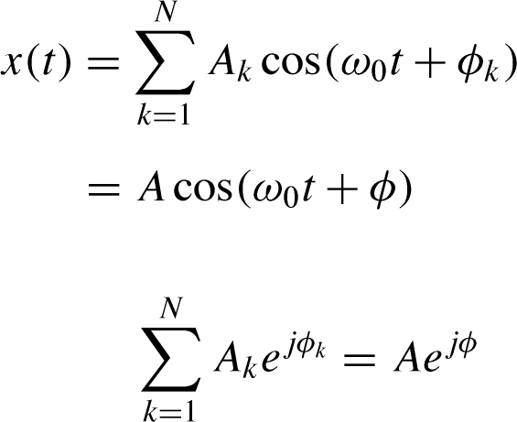
PHASOR ADDITION RULE
Get the new complex amplitude by complex addition
© 2003, JH McClellan & RW Schafer

Slide 14
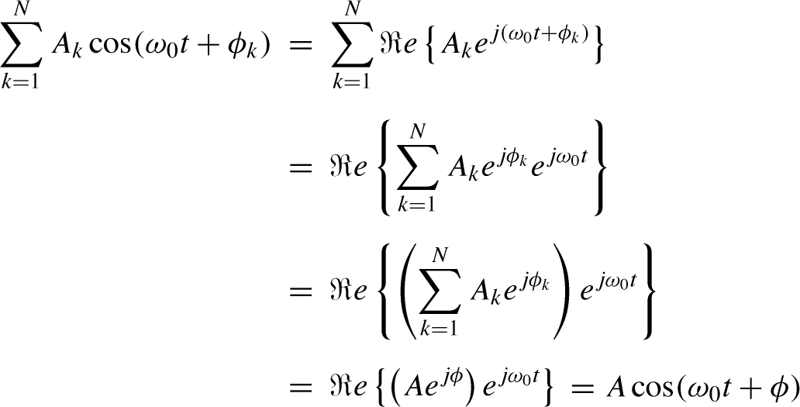
Phasor Addition Proof
© 2003, JH McClellan & RW Schafer

Slide 15
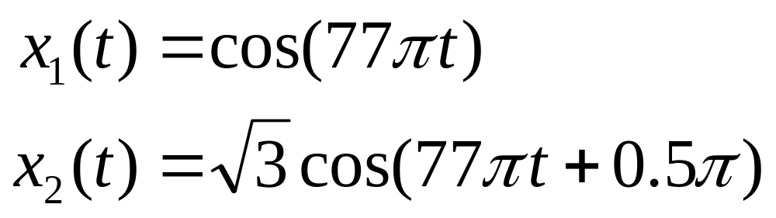
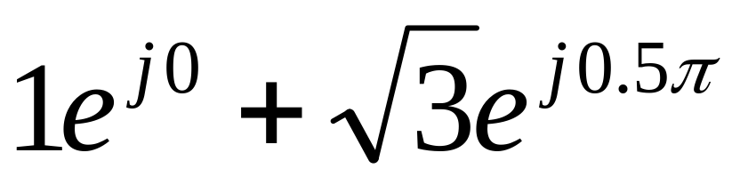
POP QUIZ: Add Sinusoids
ADD THESE 2 SINUSOIDS:
COMPLEX ADDITION:
© 2003, JH McClellan & RW Schafer

Slide 16
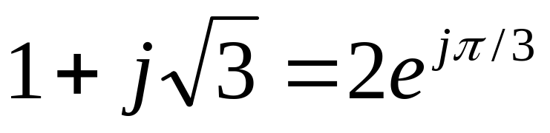
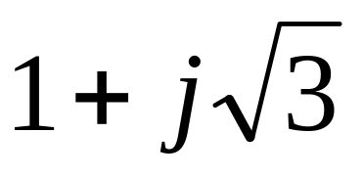
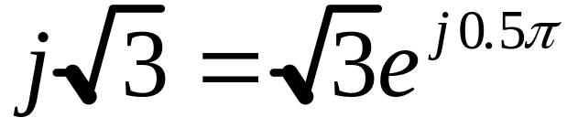

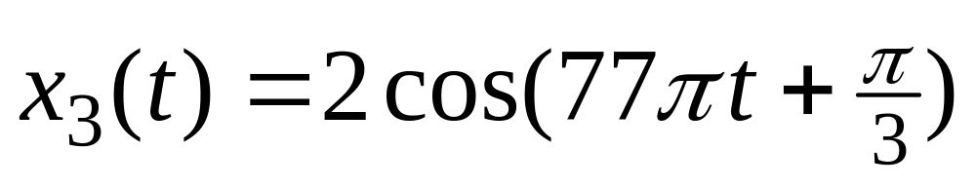
POP QUIZ (answer)
COMPLEX ADDITION:
CONVERT back to cosine form:
© 2003, JH McClellan & RW Schafer

Slide 17
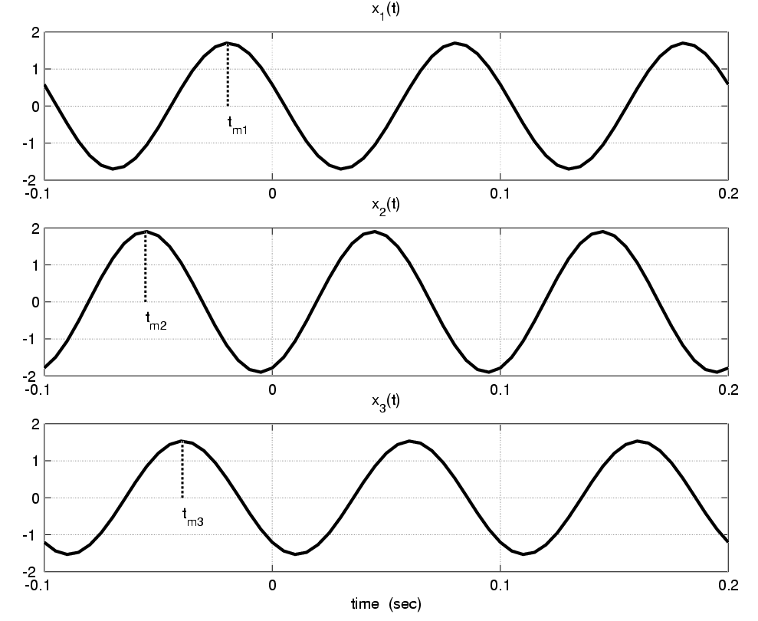
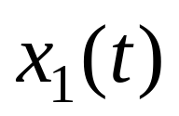
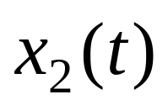

ADD SINUSOIDS EXAMPLE
t_{m1}
t_{m2}
t_{m3}
© 2003, JH McClellan & RW Schafer

Slide 18
Convert Time-Shift to Phase
Measure peak times:
  t_{m1}=-0.0194, t_{m2}=-0.0556, t_{m3}=-0.0394
Convert to phase (T=0.1)
  φ₁=-ωt_{m1} = -2π(t_{m1} /T) = 70π/180,
  φ₂= 200π/180
Amplitudes
  A₁=1.7, A₂=1.9, A₃=1.532
© 2003, JH McClellan & RW Schafer

Slide 19
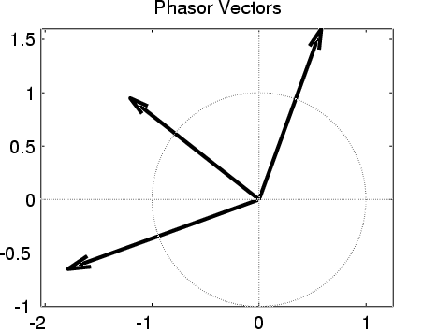
Phasor Add: Numerical
Convert Polar to Cartesian
  X₁ = 0.5814 + j1.597
  X₂ = -1.785 - j0.6498
  sum =
  X₃ = -1.204 + j0.9476
Convert back to Polar
  X₃ = 1.532 at angle 141.79π/180
  This is the sum
© 2003, JH McClellan & RW Schafer

Slide 20
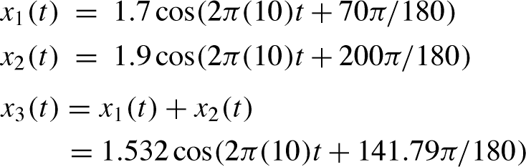
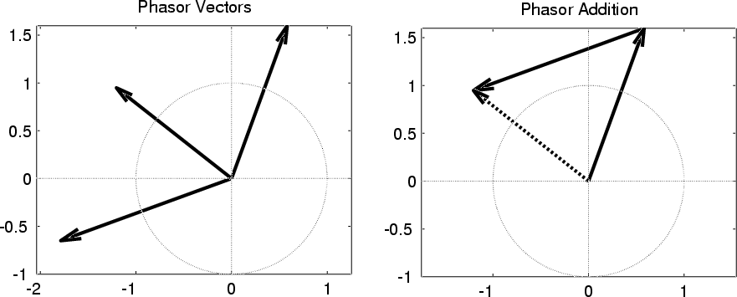
ADD SINUSOIDS
X₁
VECTOR
(PHASOR)
ADD
X₃
X₂
© 2003, JH McClellan & RW Schafer

